Slide 1
SPAN Image Analytics Stage One Update
Ryan P. Cabeen
March 31, 2021

Slide 2
Analytics Pipeline Overview
IDA
Download
Image Preprocessing
Parameter Estimation
Brain Extraction
Parameter Harmonization
Analytics Report and Visualizations
Aggregate Imaging Metrics
Midline Shift Quantification
Lesion and CSF Segmentation
Atlas Registration

Slide 3
Analytics Pipeline Overview
IDA
Download
Image Preprocessing
Parameter Estimation
Brain Extraction
Parameter Harmonization
New Stuff
Analytics Report and Visualizations
Aggregate Imaging Metrics
Midline Shift Quantification
Lesion and CSF Segmentation
Atlas Registration

Slide 4
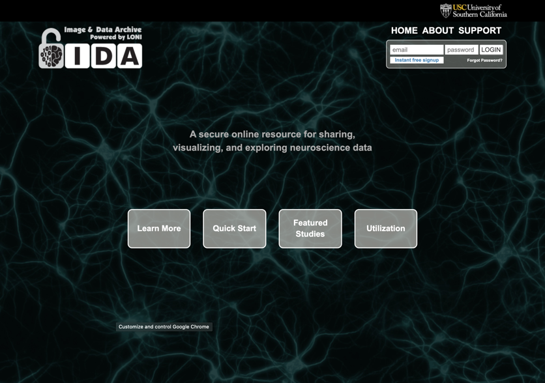
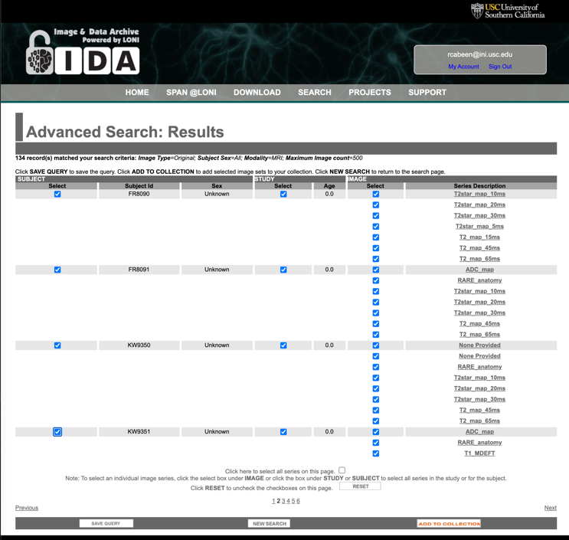
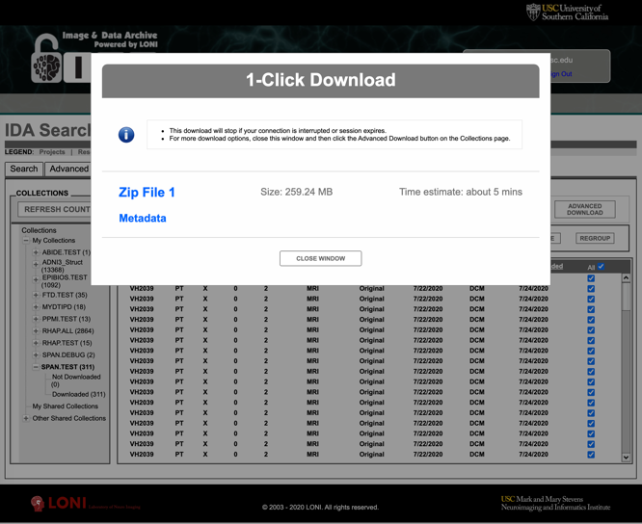
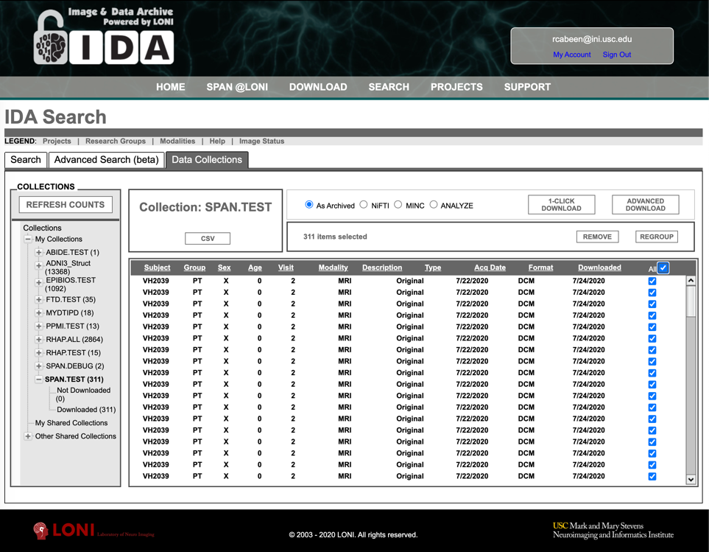
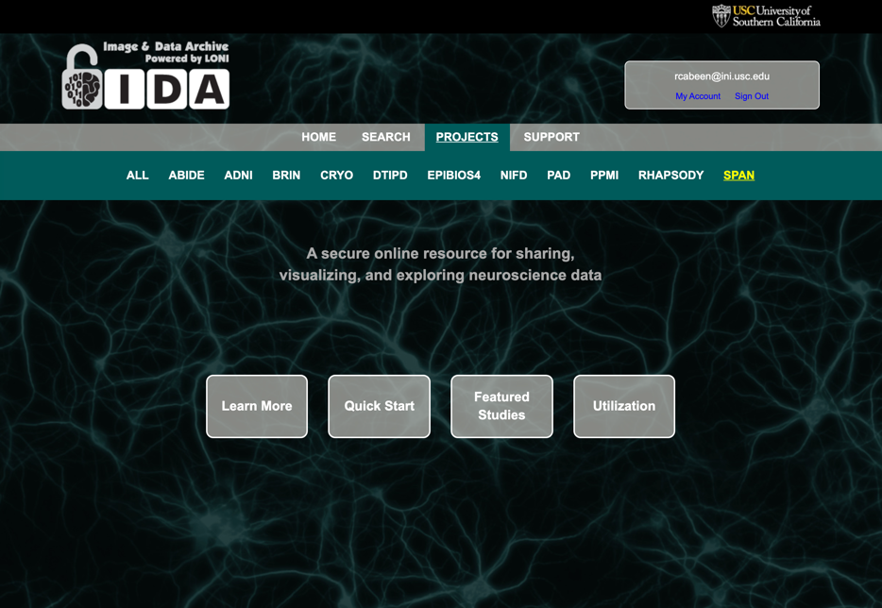
LONI IDA Data Wrangling Process
Download
Query
Login
Next steps…
Collect

Slide 5
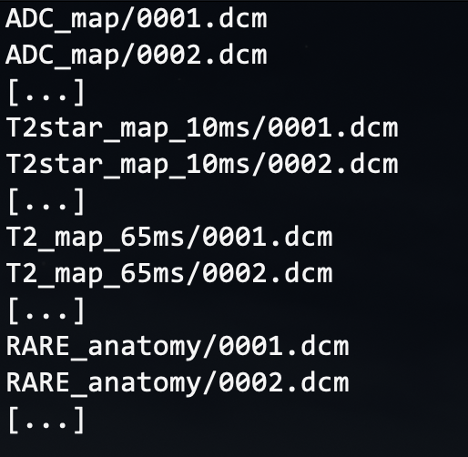
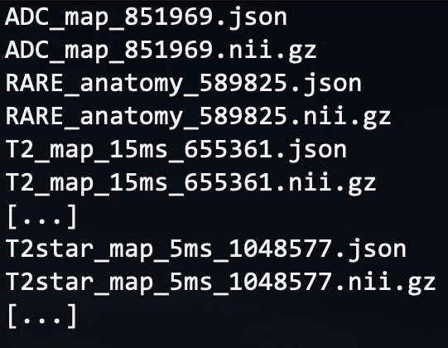
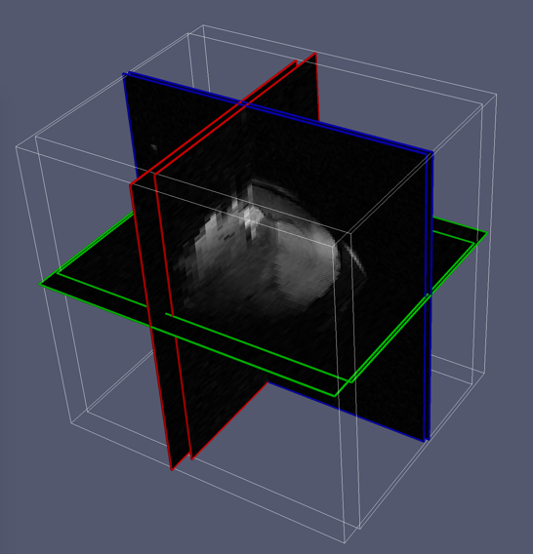
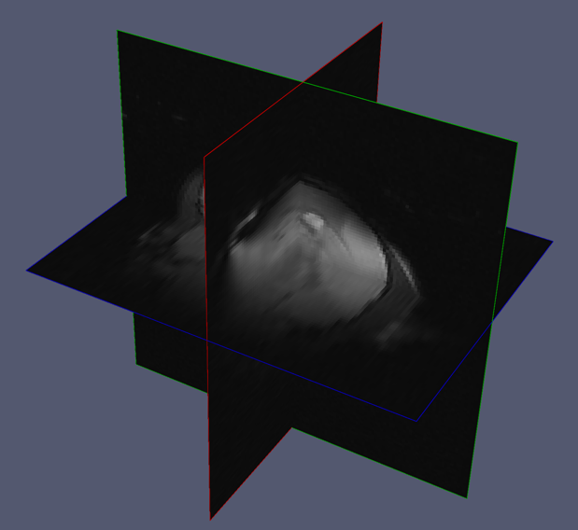
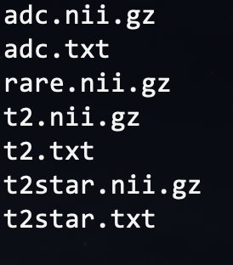
Preprocessing Step: Data Wrangling
File Format Conversion
DICOM to NIfTI
Extract
Meta-data (site & scan parameters)
Harmonize
3D Image orientation and resolution
Collect, Sort and Harmonize Scans
…
(note: DICOM names shortened for clarity)
(some sites use a different FOV within a single session)
(we harmonize the data to remove these differences)

Slide 6
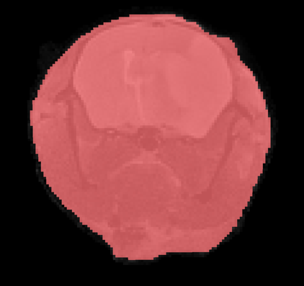
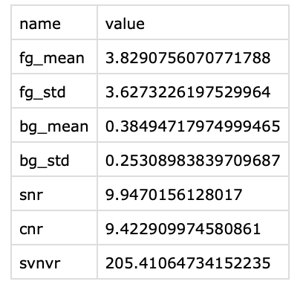
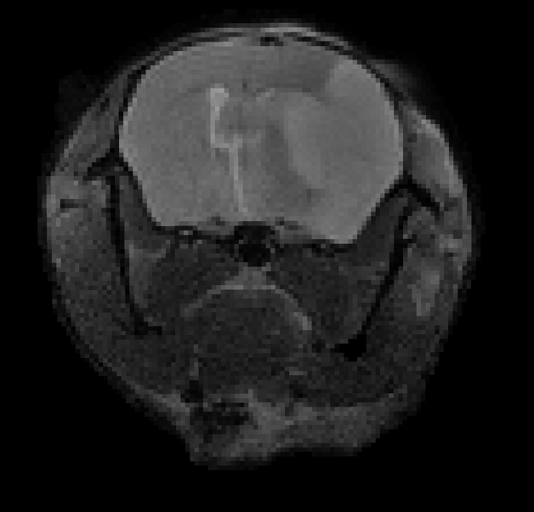
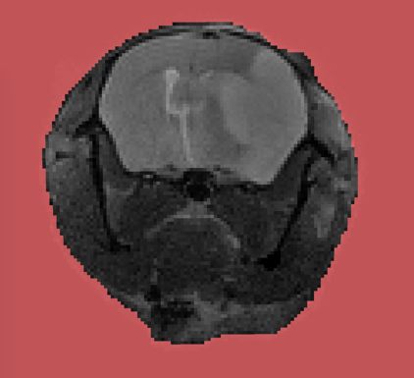
Preprocessing Step: Quality Assessment
Foreground
Metrics
Background
Input Scan
(repeat for ADC, T2, T2-star)
SNR= μ_{FG} / μ_{BG}
CNR= σ_{FG} / μ_{BG}
SVNVR= σ_{FG} / σ_{BG}
Signal Mean (μ) and Std. Deviation (σ) of Foreground (FG) and Background (BG)

Slide 7
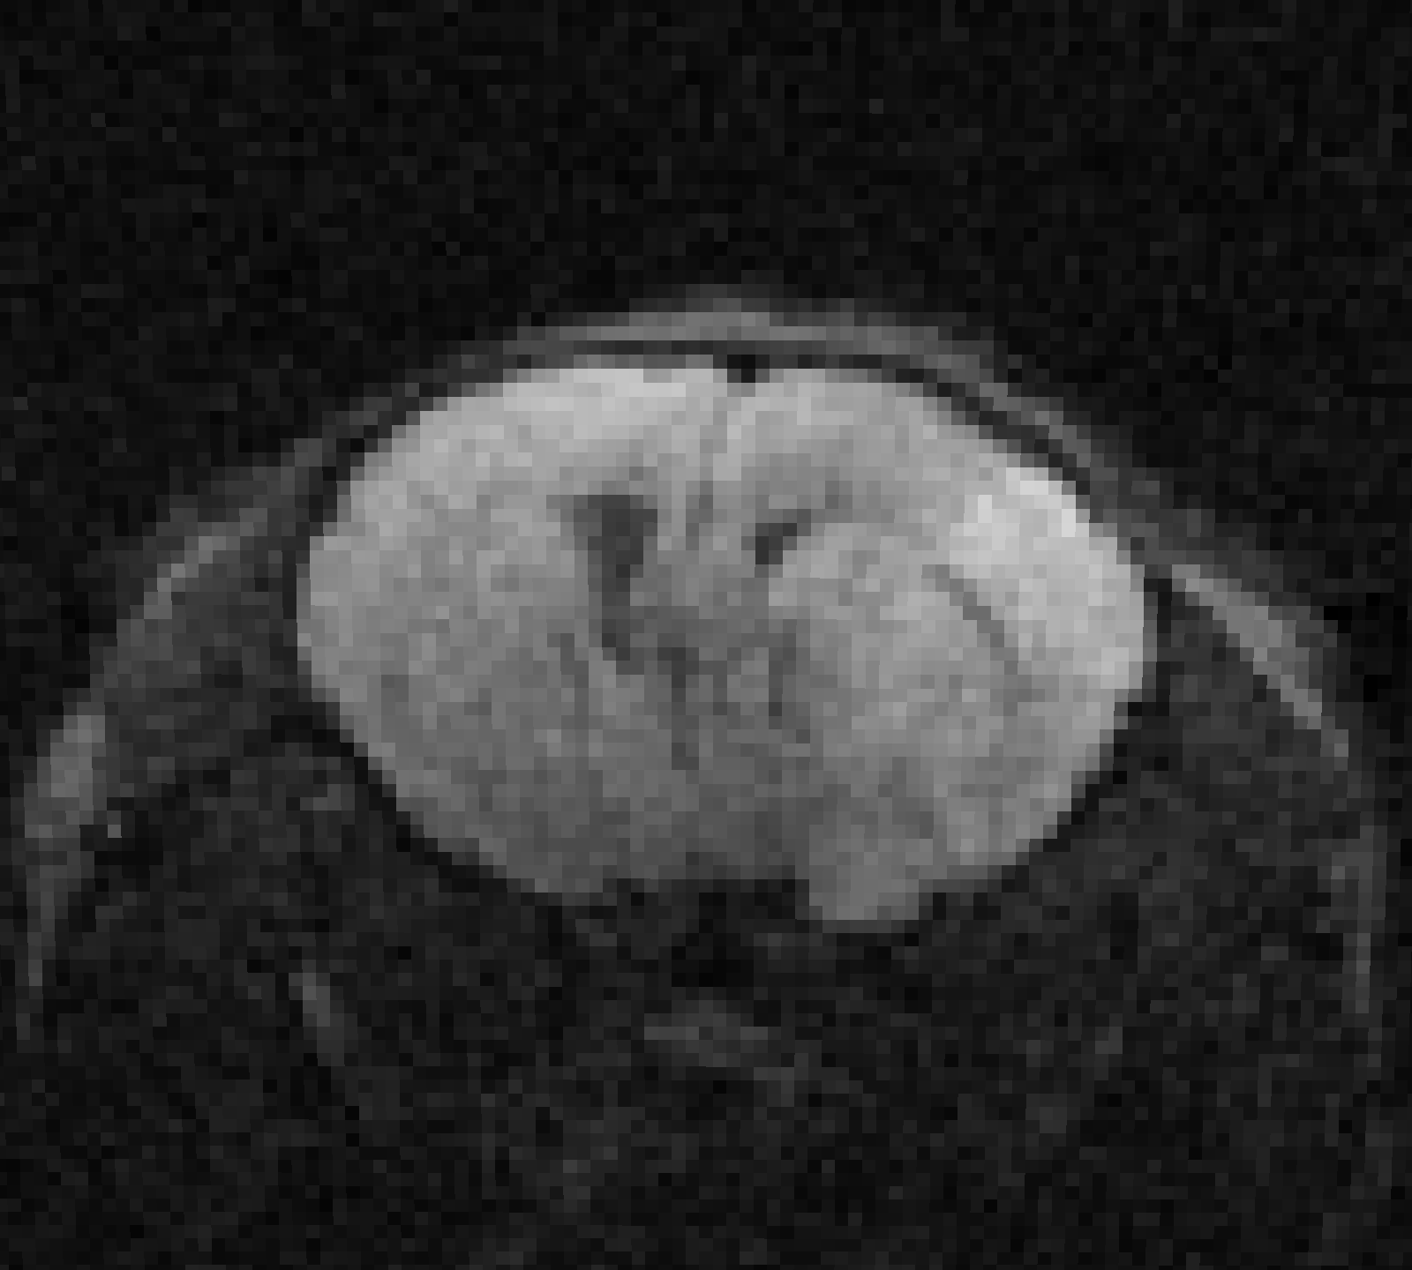
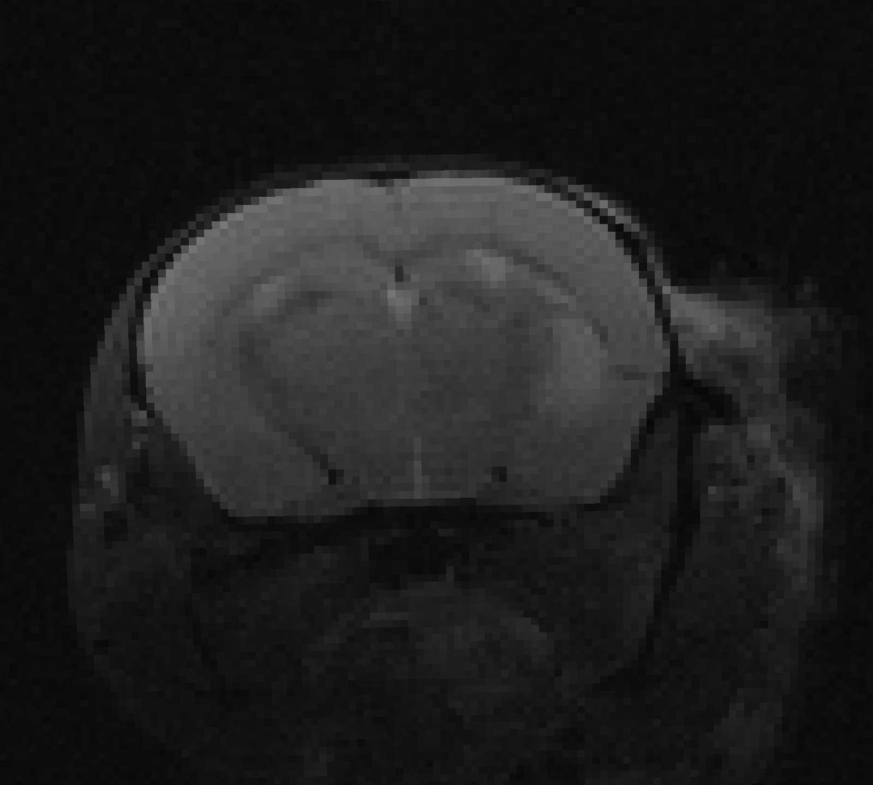
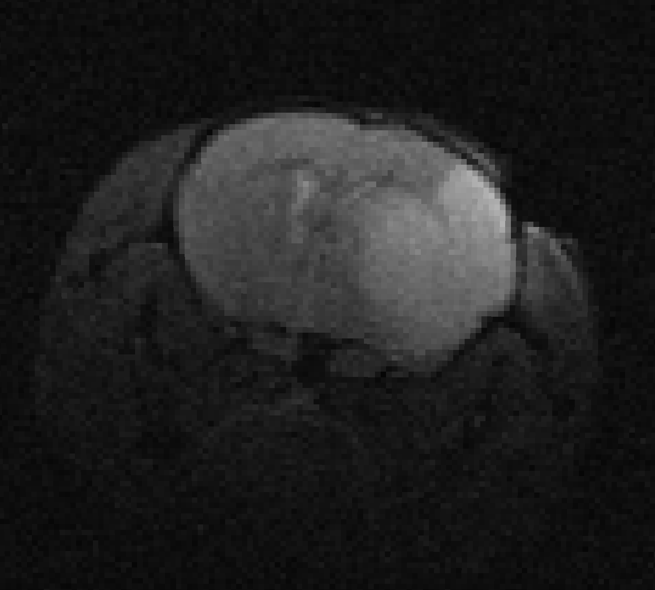
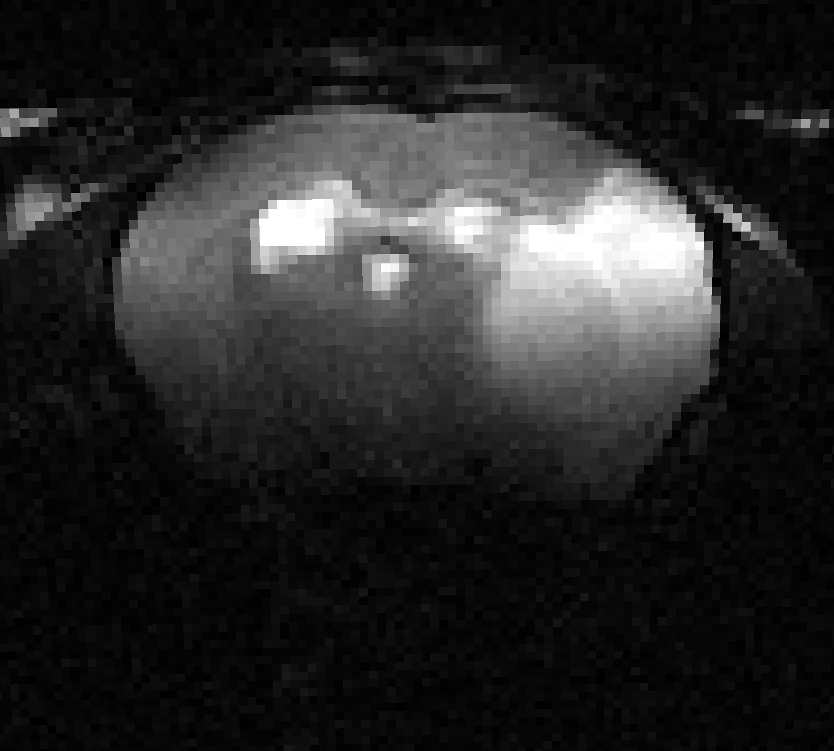
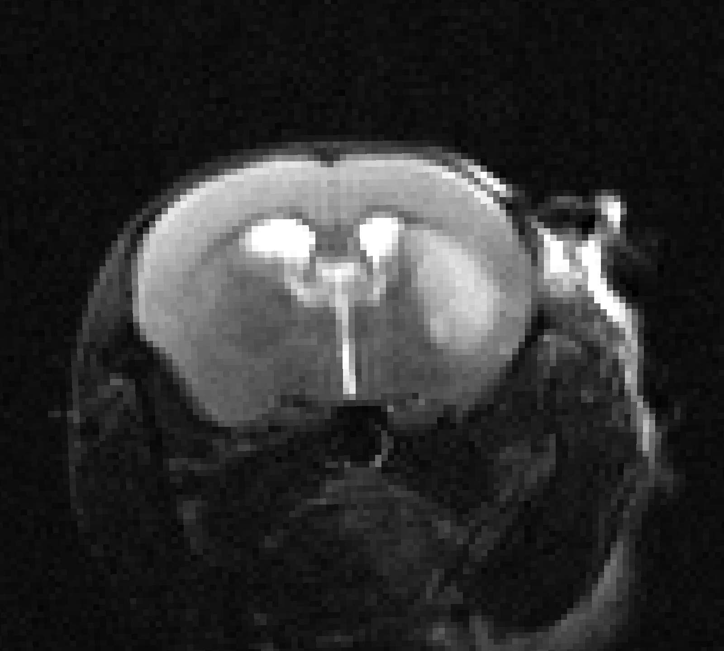
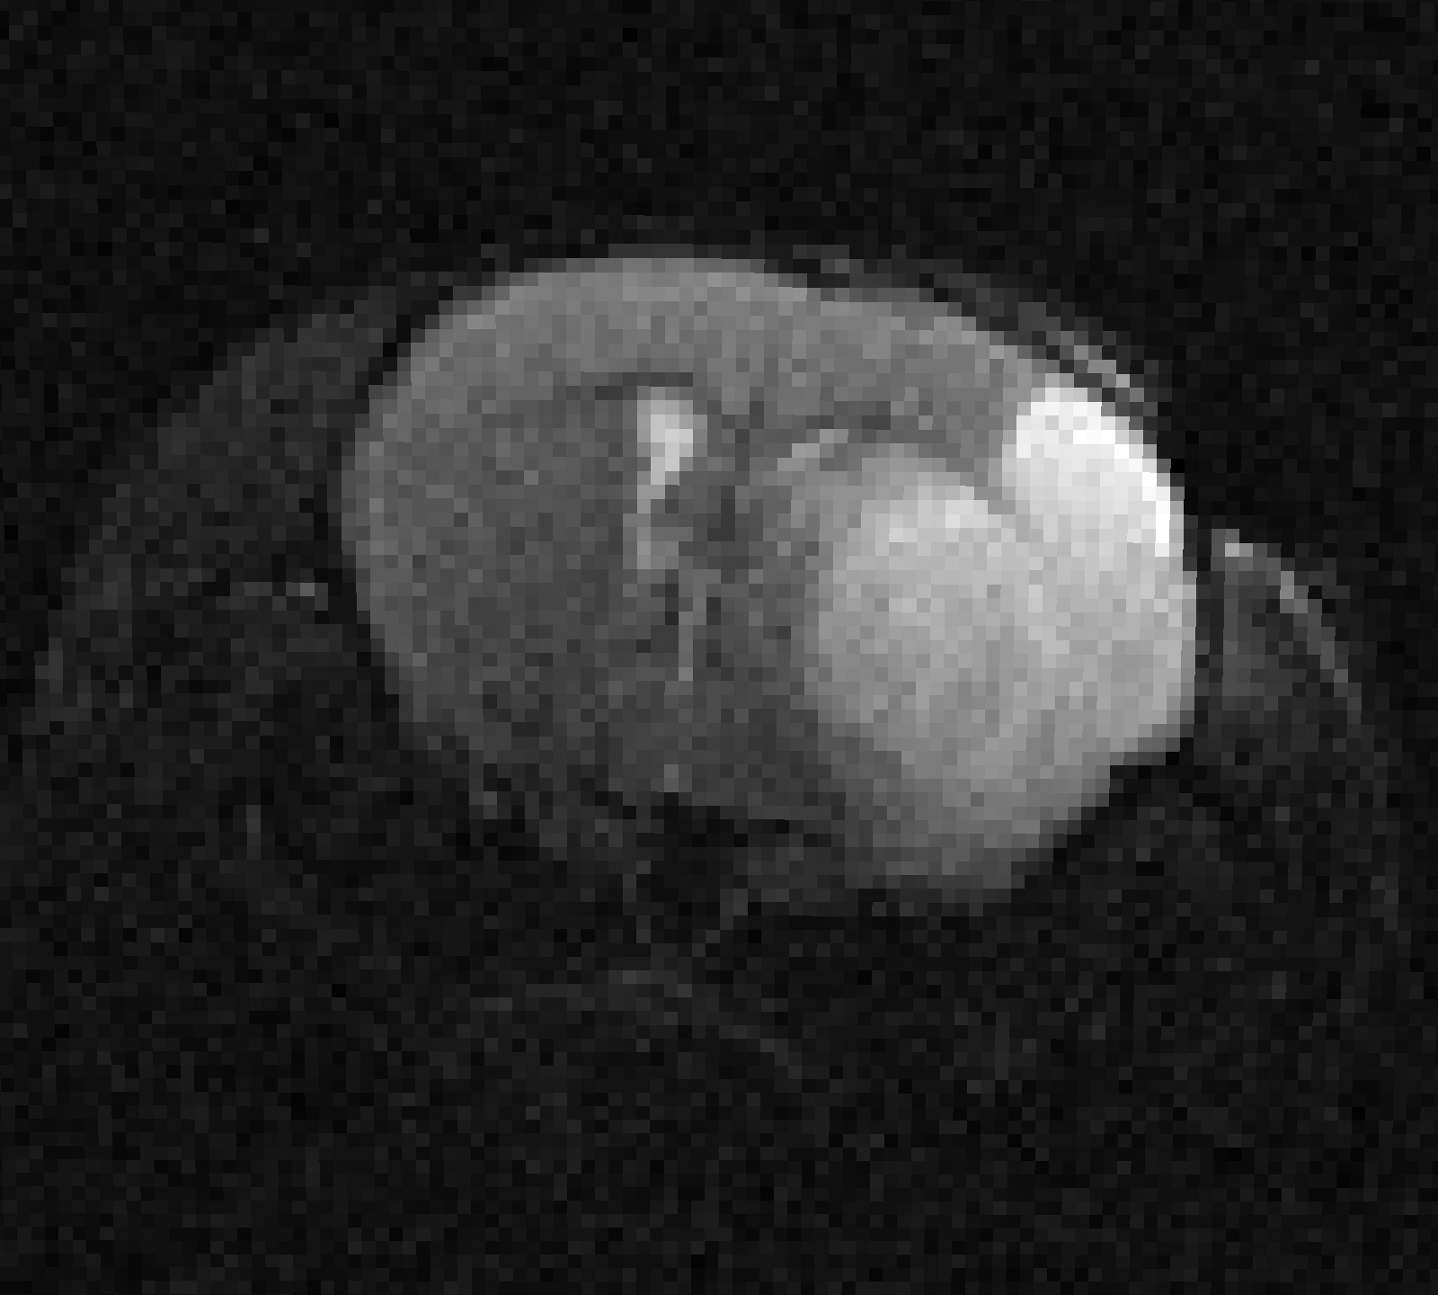






Preprocessing Step: Denoising
Raw
Denoised
Approach: Non-local means denoising with local noise estimation, applied to each component scan

Slide 8
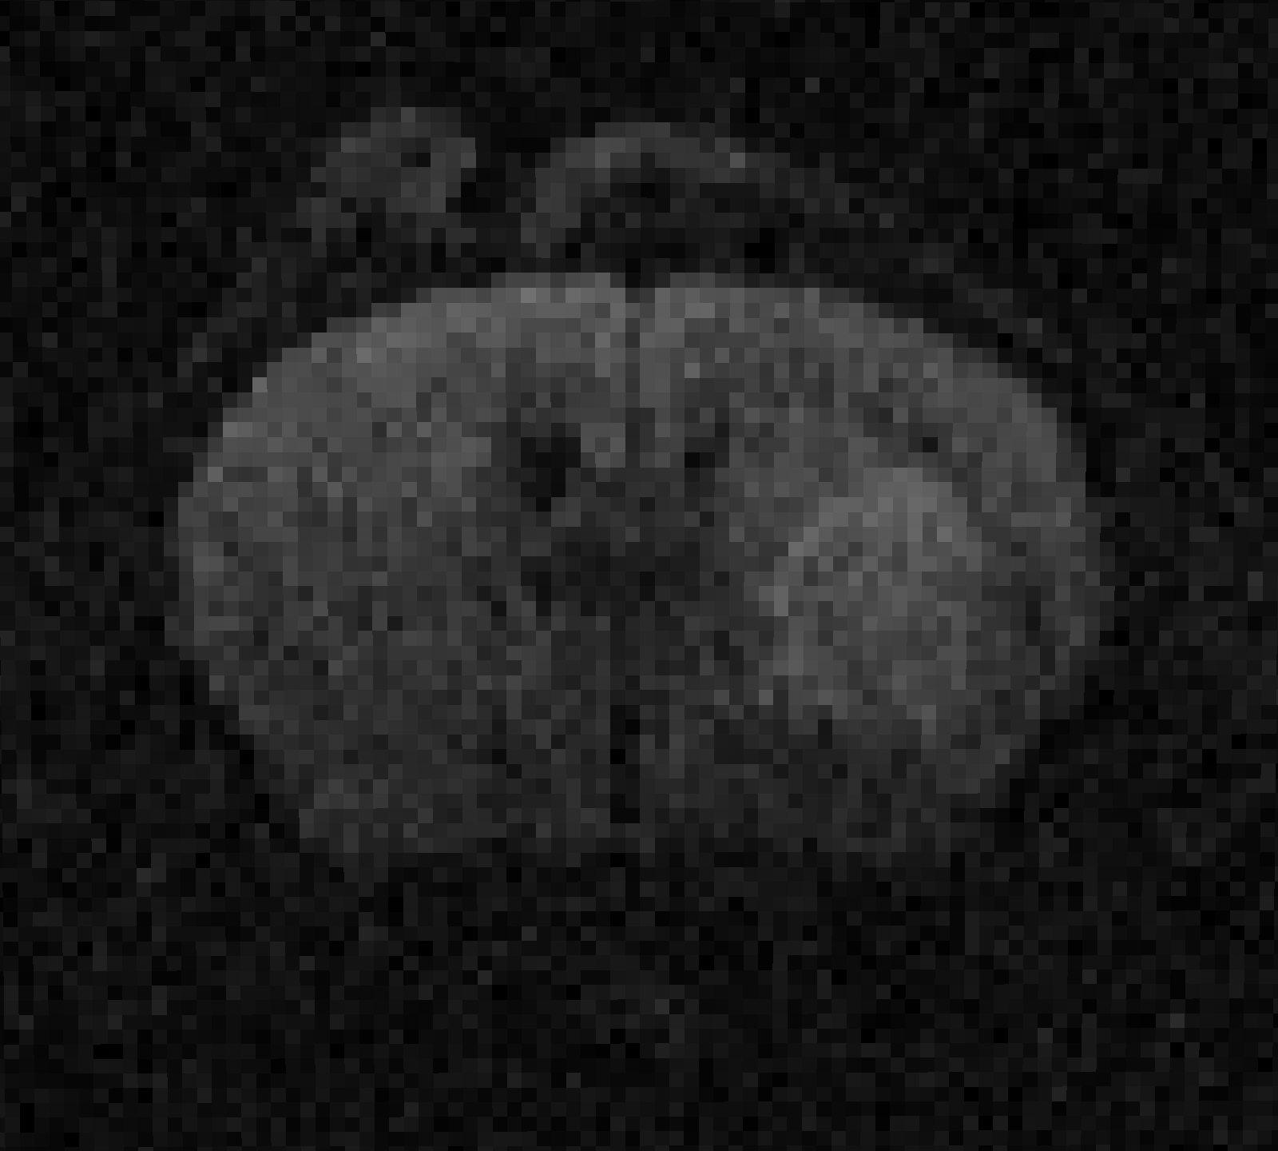
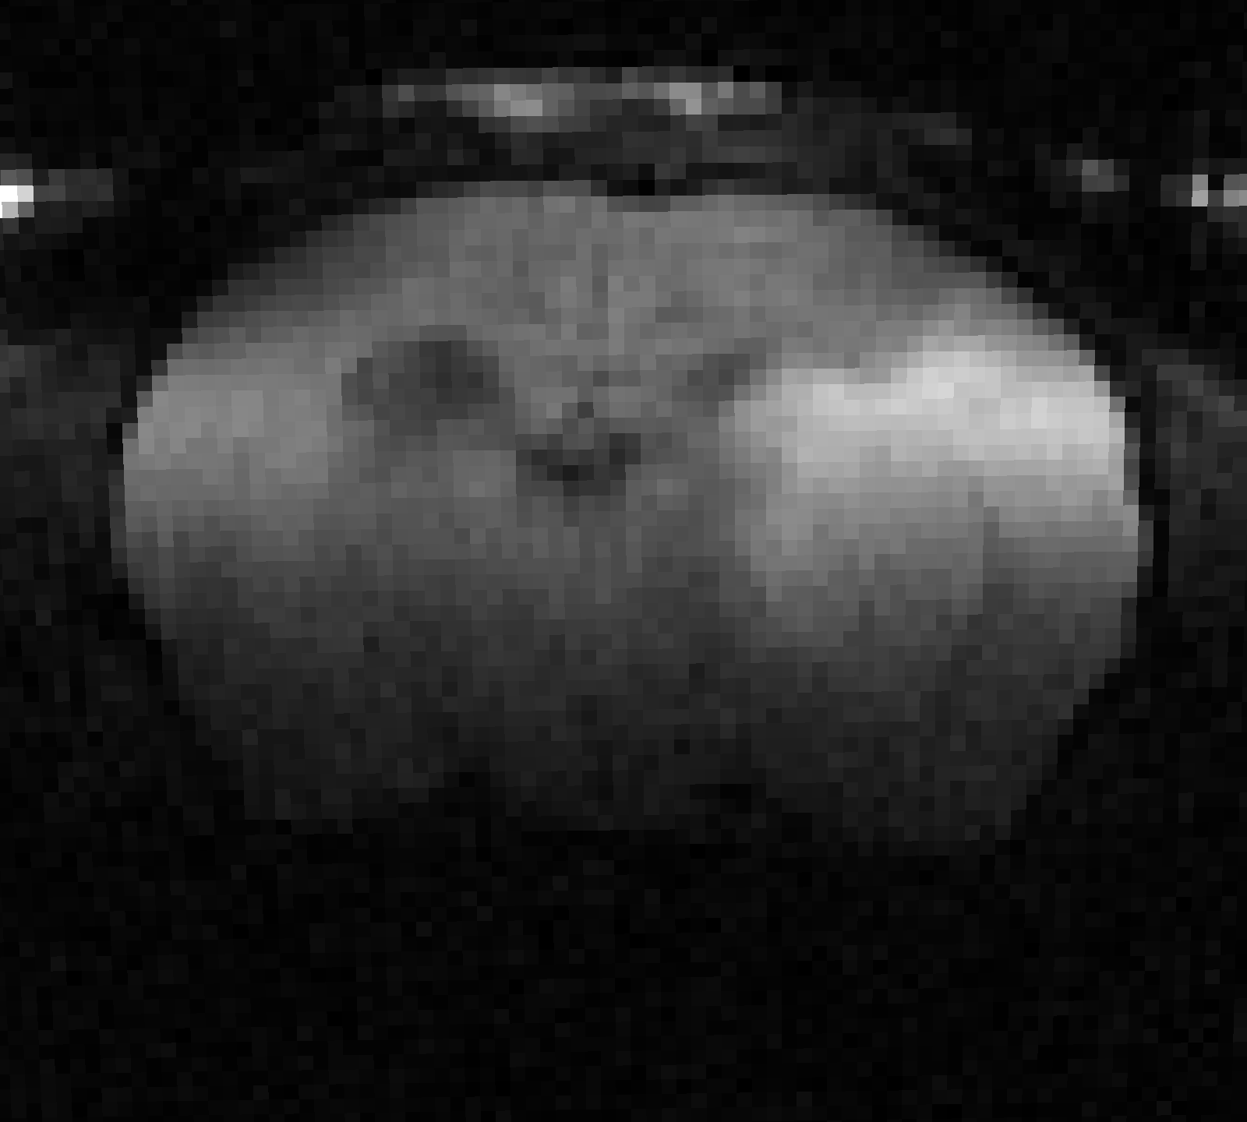
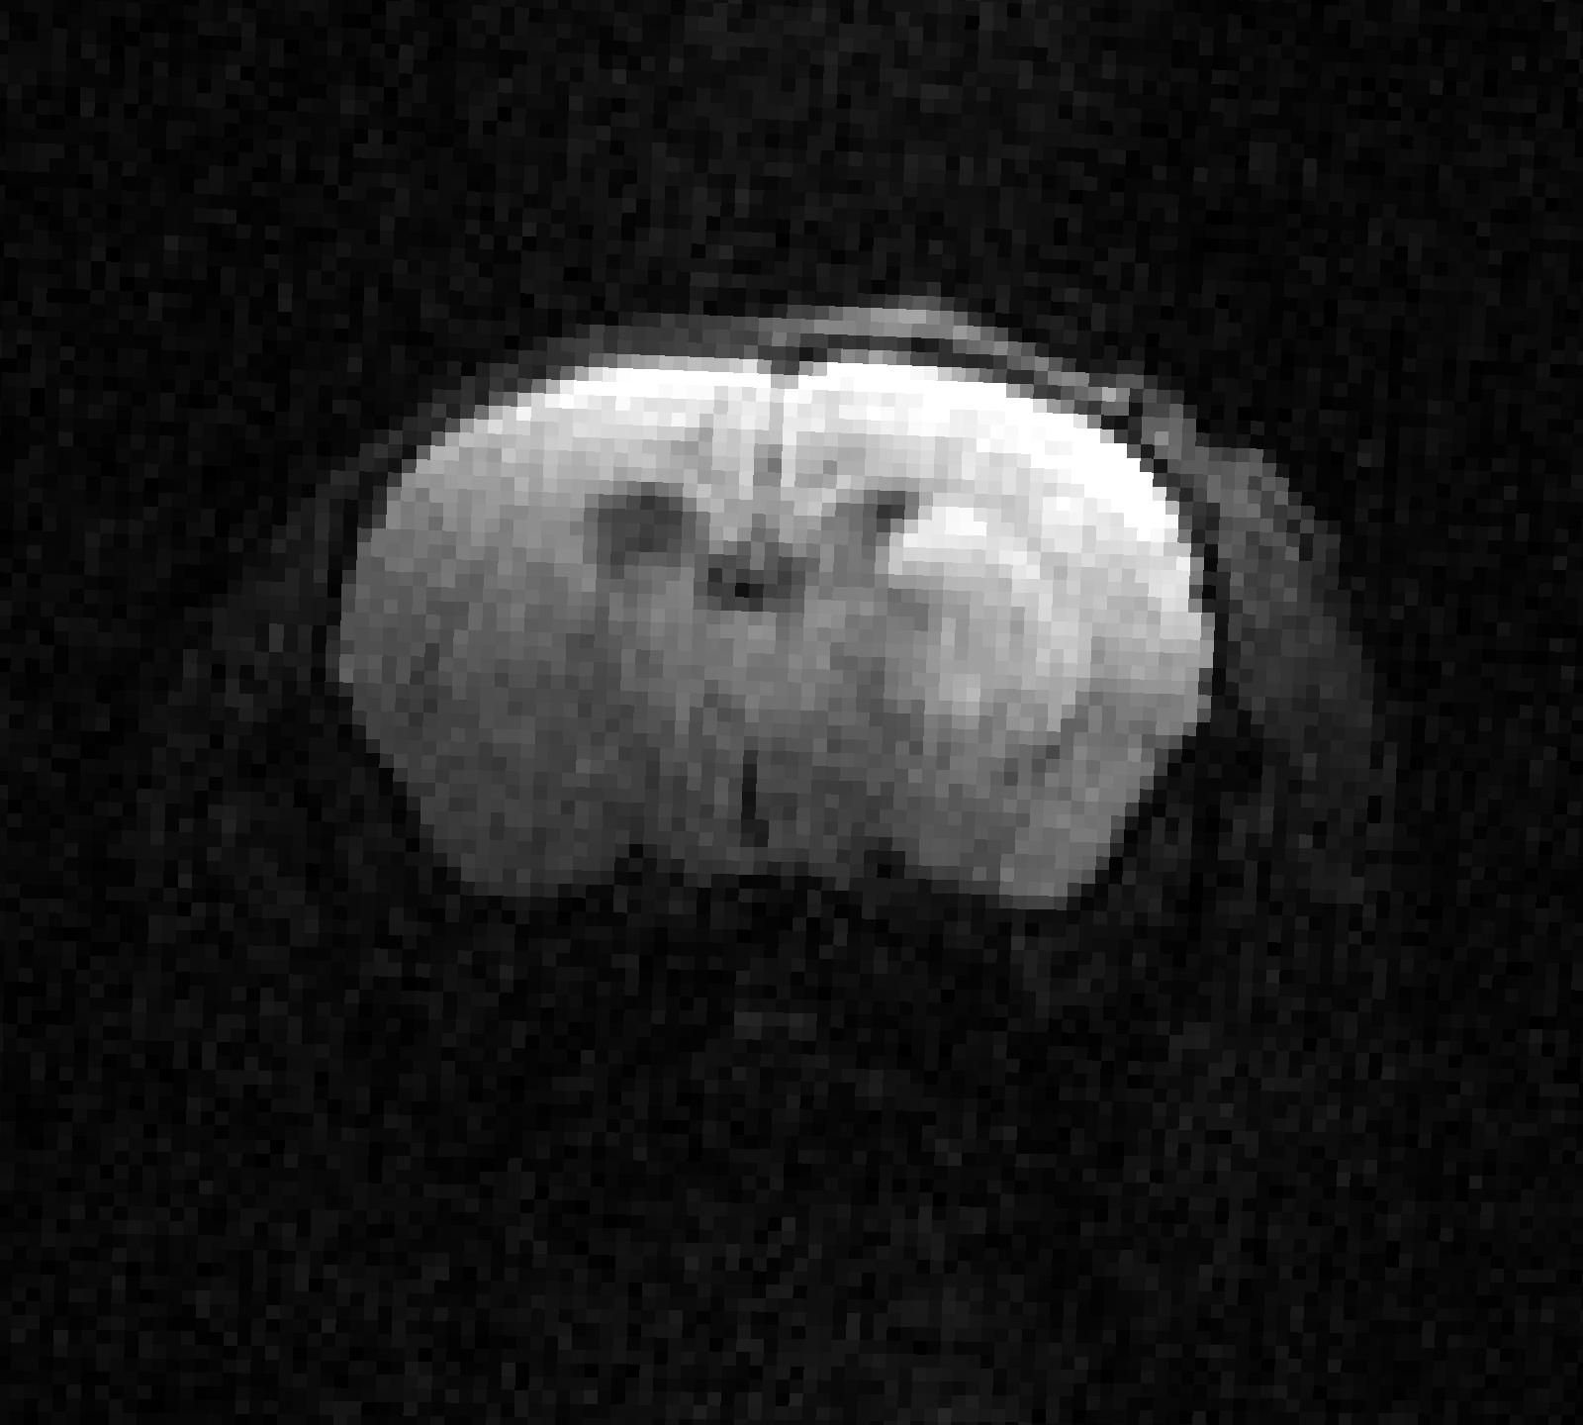



Preprocessing Step: Denoising ADC scans
AG
YL
UI
JH
MG
UT
Approach: Non-local means denoising with local noise estimation, applied to each component scan

Slide 9
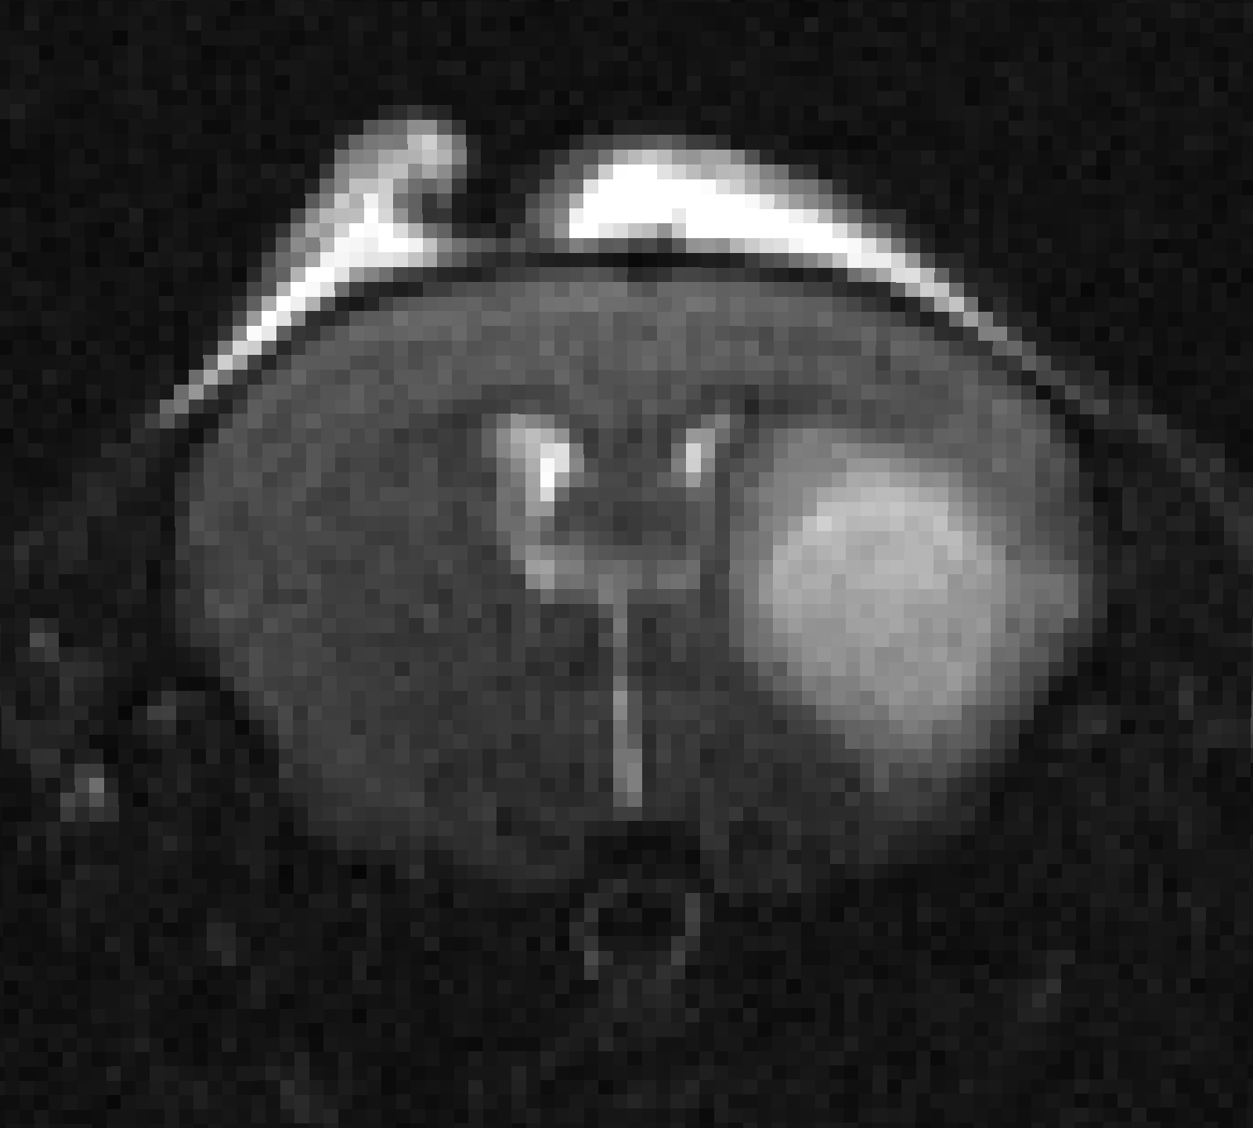
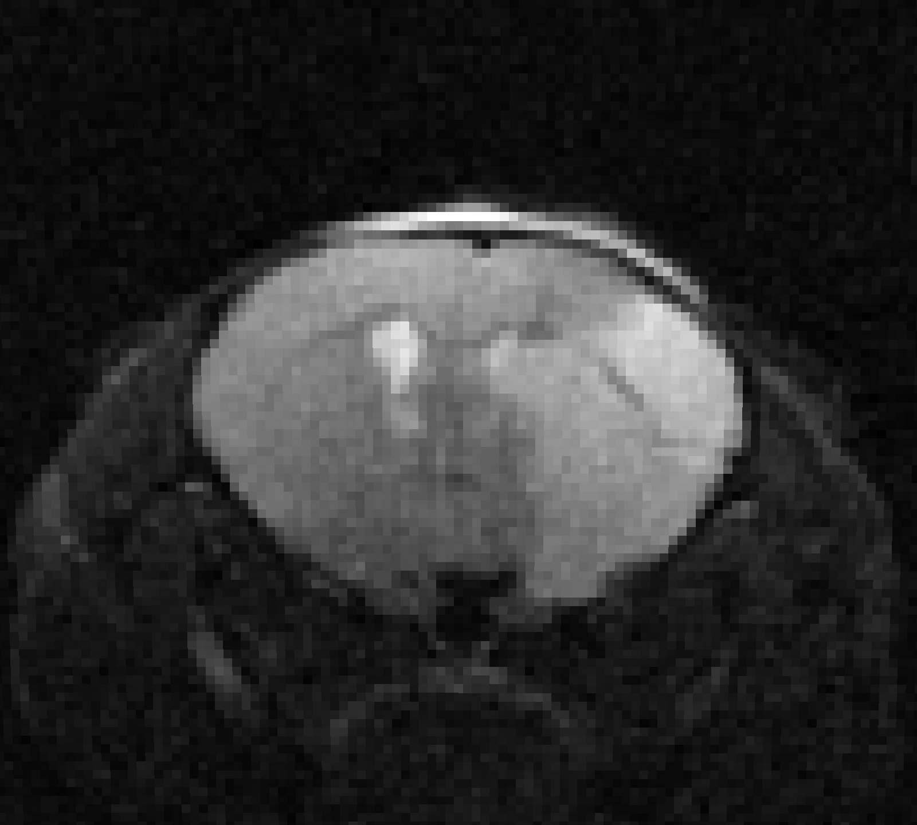
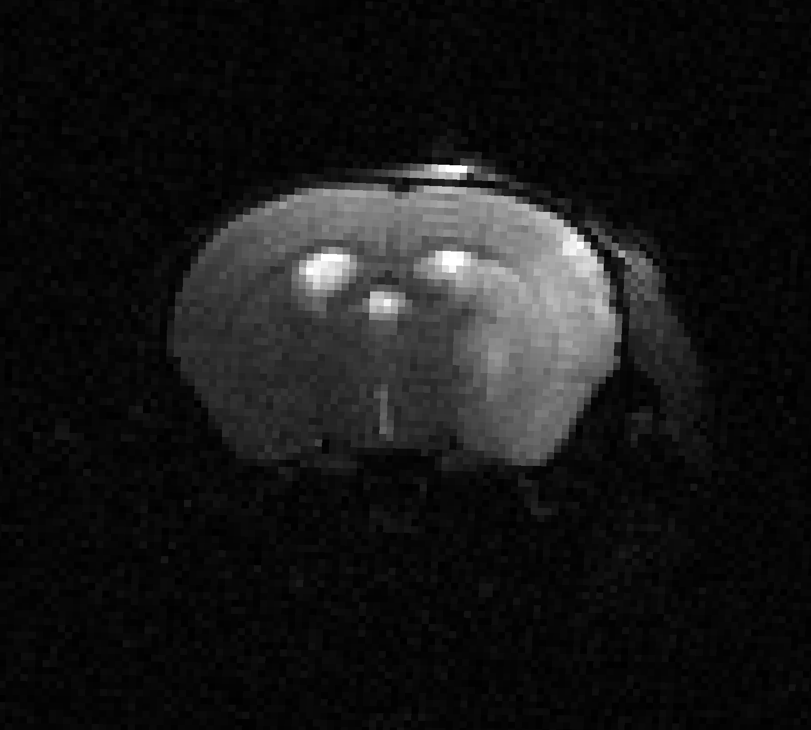



Preprocessing Step: Denoising T2 scans
AG
YL
UI
JH
MG
UT
Approach: Non-local means denoising with local noise estimation, applied to each component scan

Slide 10
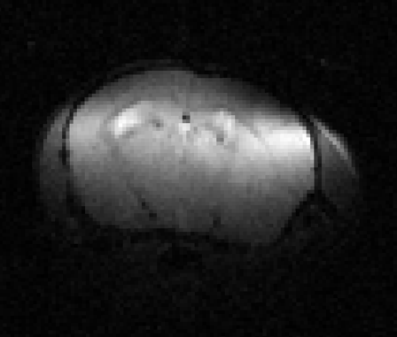
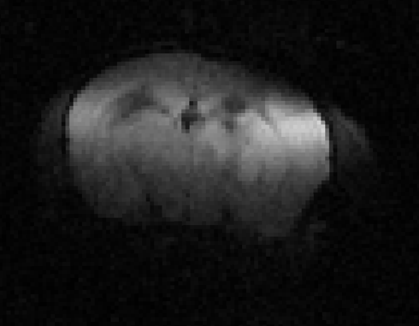
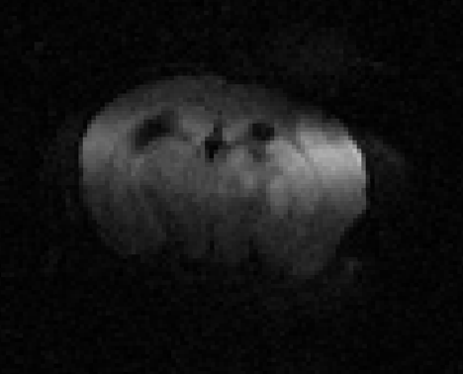
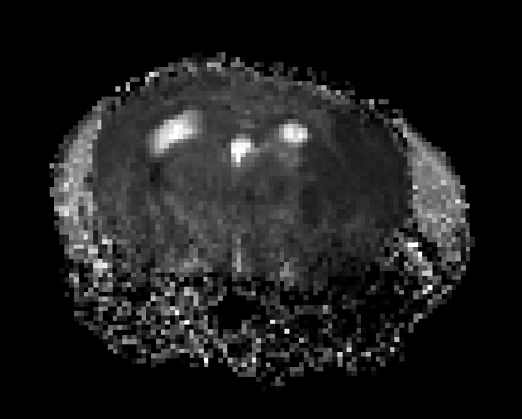
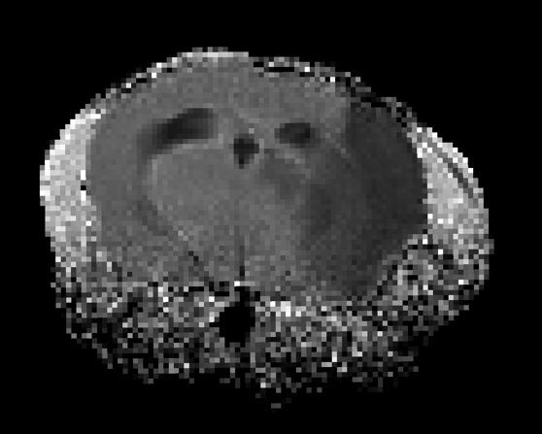
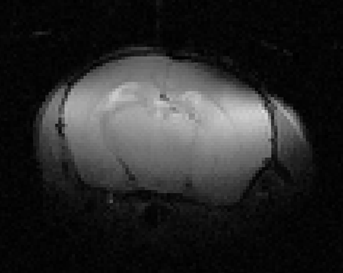
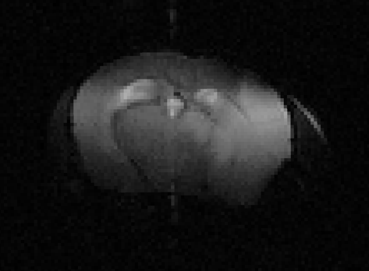
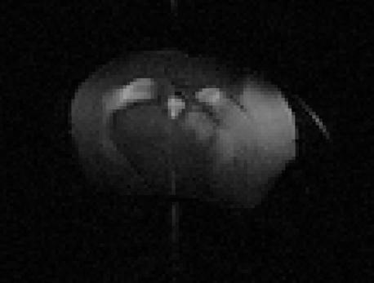
Parameter Estimation
Estimating the Apparent Diffusivity Coefficient (ADC) from multiple b-values
Fitting
b=0 s/mm²
b=500 s/mm²
b=1000 s/mm²
ADC
Estimating the T2 Relaxation Rate from multiple echo times
Fitting
TE=15ms
TE=45ms
TE=60ms
…
T2

Slide 11
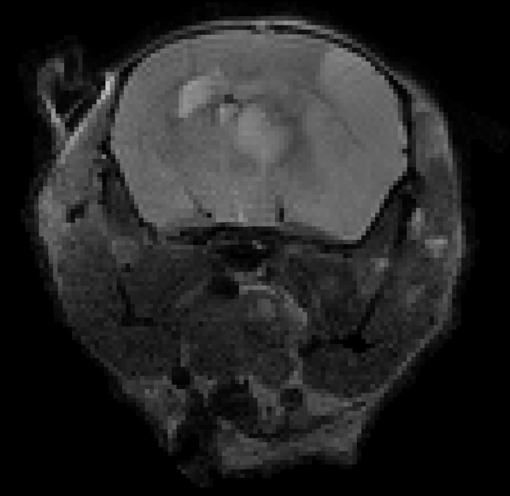
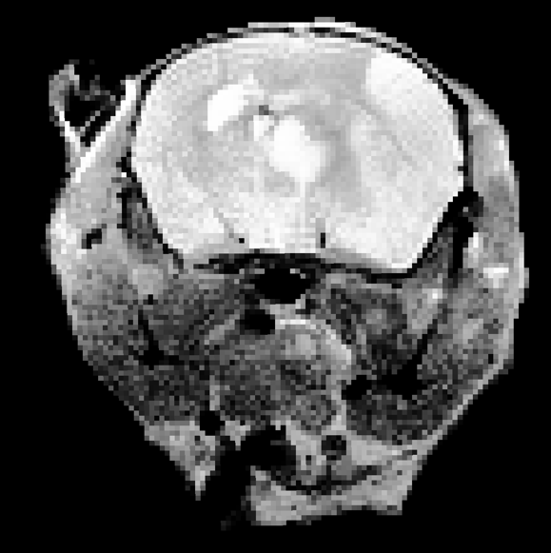
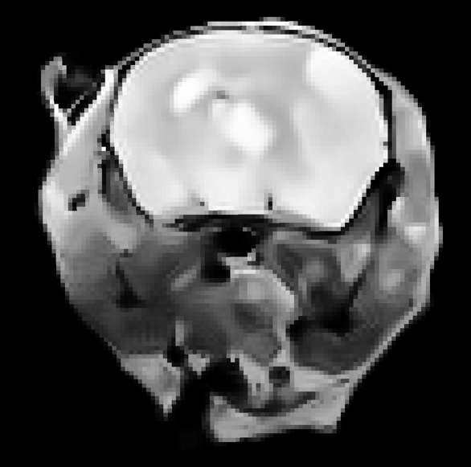
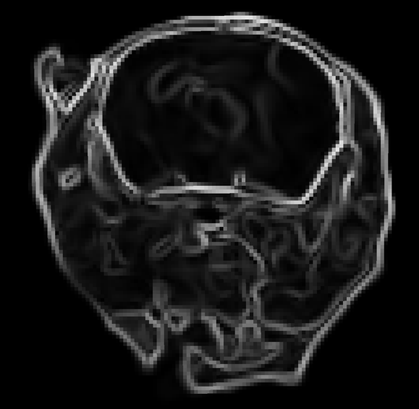
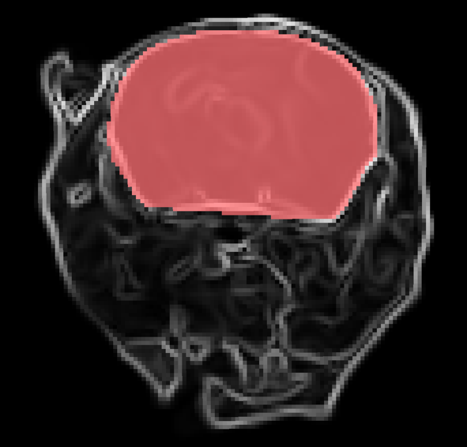
Brain Extraction with a Traditional Approach
Input Scan
Enhanced Contrast
Regularized
Gradients
Brain Segmentation
Approach:
Use traditional brain extraction pipeline:
Contrast enhancement
Edge-preserving smoothing
Gradient magnitude
Component segmentation

Slide 12
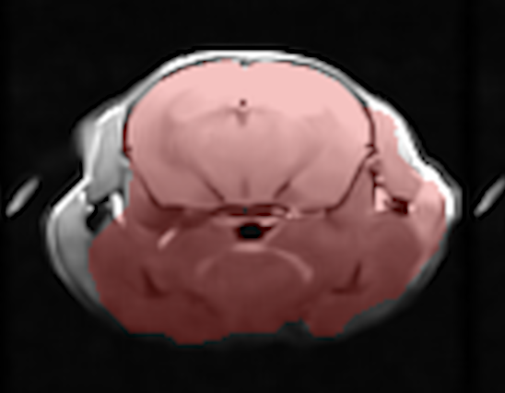
Robust Brain Extraction with Deep Learning
Problem:
Our first brain extraction algorithm works well, but with a 5% error rate, due to blurring at skull-brain boundary causing “leaking”, irrespective of site/time

Slide 13

Robust Brain Extraction with Deep Learning
Problem:
Our first brain extraction algorithm works well, but with a 5% error rate, due to blurring at skull-brain boundary causing “leaking”, irrespective of site/time
Ronneberger, et al., MICCAI 2015
Solution:
Use a U-net deep learning algorithm:
select the 300 best example results
balanced by site and timepoint,
use them to train, validate, and test
collect and test failure cases

Slide 14
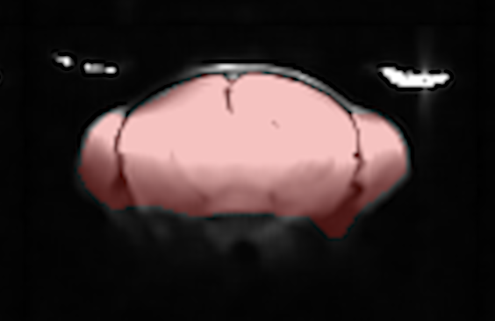
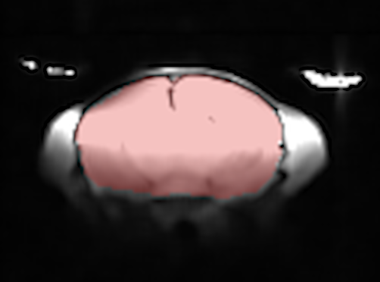
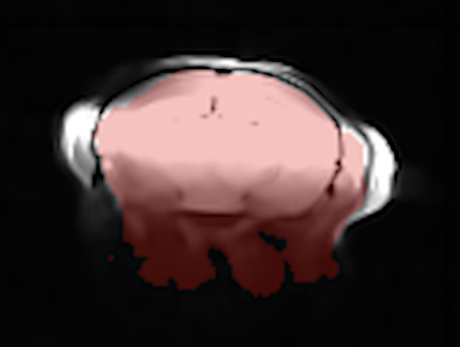
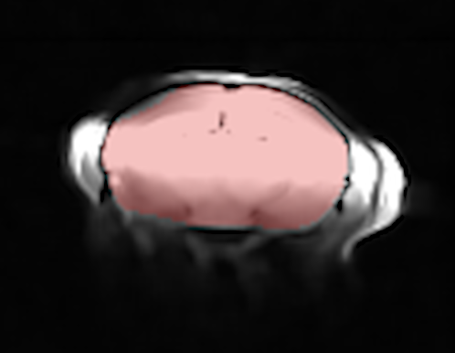
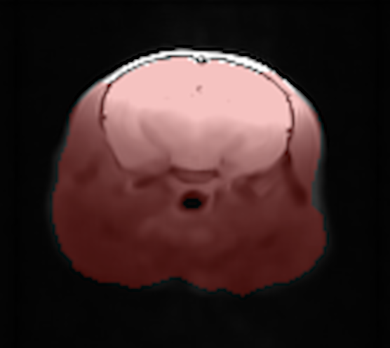
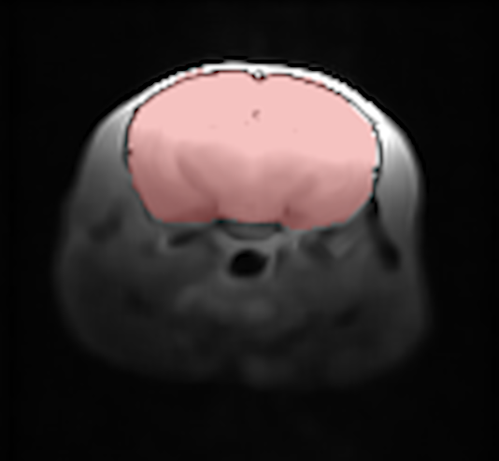
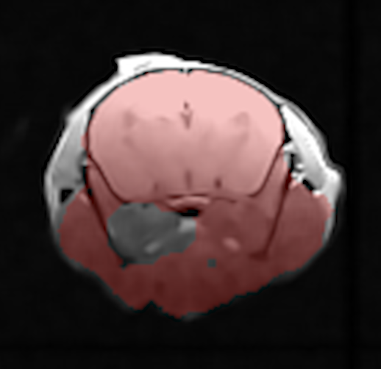
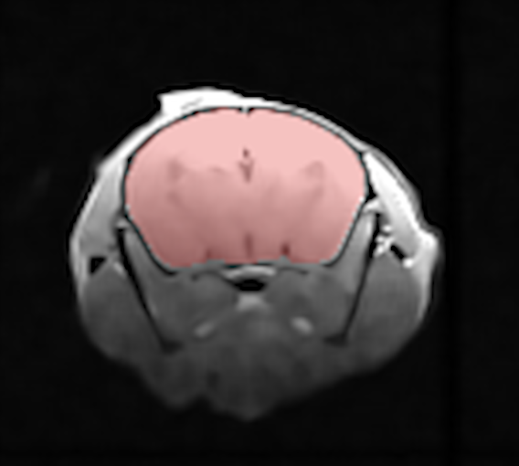
Robust Brain Extraction with Deep Learning
Traditional
U-net
Traditional
U-net
Results: Neural network approach accurately reproduces previous approach with 96% accuracy and fixes all failed cases

Slide 15
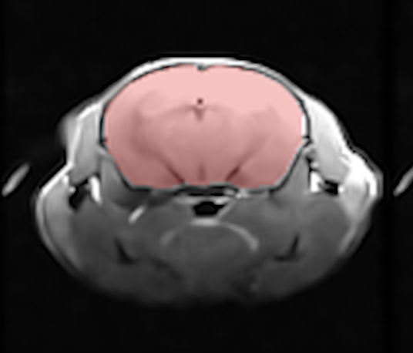
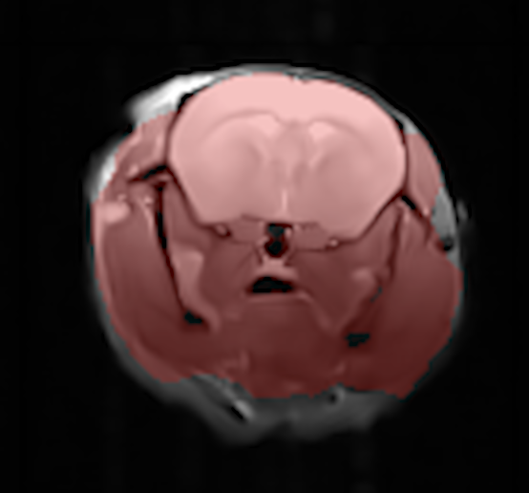





Robust Brain Extraction with Deep Learning
Traditional
U-net
Traditional
U-net

Slide 16






Atlas registration
MacKenzie‐Graham, et al. (2007). Epilepsia
BMAT Atlas
Native Space
Atlas
Normalized
Midline Ventricle Limit
Lesion Limit
Approach: Perform rigid registration to the atlas to preserve morphometry, standardize head pose, and provide limits on lesion and ventricle (shown on right)

Slide 17


Parameter Harmonization Across Sites
Challenge: There are some systematic inter-site differences in parameter maps
Approach: Use a statistical harmonization procedure to uniformly scale the image to standardize normal appearing tissue
Results: We can use common thresholds for lesion (T2 < 0.775) and CSF (ADC > 1.65)

Slide 18





Lesion and CSF Segmentation
ADC
CSF
T2
Lesion
Approach:
Lesion from dark R2 & bright ADC
CSF from dark R2 & bright ADC
Regularization to label voxels
Rest is normal appearing tissue

Slide 19


Midline shift quantification
CSF
CSF
Approach:
Select a thin coronal section of ventricles based on atlas
Compute centroid and extremal left-right points of brain
Measure absolute and relative measures of brain shift
Segment left and right hemisphere atrophy (assuming a parabolic surface)

Slide 20



Analytics and Report Generation
Summary metrics:
Image quality
Lesion, CSF, and tissue* volume
Total brain volume (sum of above)
Mid-line shift indexes
Per-hemisphere tissue* volumes
Others are possible…
Visualizations:
Mosaic plots of images
Overlays of segmentations
3D models
*by “tissue” we mean non-infarcted tissue that is normal-appearing

Slide 21

Summarizing the entire dataset
1309 scans uploaded to IDA
779 early timepoint, 530 late
13 failed due to incomplete data
25 failed due to motion

Slide 22



Slide 23



Early timepoint shifts, CSF, and lesion
Early timepoint lesion and CSF
Late timepoint shifts and CSF

Slide 24




Slide 25


Slide 26


